Slide 1

Predicting Market Values of the Football Players
Team 3

Slide 2


The reason why we selected this topic?
Nowadays, FIFA is the most important association that governs football federations all over the planet and attracts a lot of fans. Because of its popularity, many football associations obtain huge incomes. Thus, soccer clubs are companies. These companies always make important decisions in relation to who football player they want to employ. It has been a fact that transfers of players make a significant impact on football clubs, cities, countries, and governments. Also, the market value of players provides a budget for these transfers. Therefore, the market value of a player is important to sales and profit for the clubs, which pay attention to analysis and predict player value. So, our question is “ what kind of factors will influence the market value of a player?”

Slide 3
Questions We hope to answer with the data
what kind of factors will influence the market value of a player?
How much does the market value of the players increase on average?
Player performance and club rank can make a significant impact on player value.

Slide 4

Project Objective & Target Audience
Develop an optimal model using Multiple Regression Model to predict the market values of the players.
Target Audience
Sports statistics fans
Enthusiasts of football

Slide 5
Hypothesis
Player personal information, player performance and club market value can make a significant impact on player value.

Slide 6
Data
Develop an optimal model using Linear regression to predict the performance of the players.
Data Source
2021 Football Data clean, structured and automatically updated football data from transfermarkt.
2018 Summer window transfer.The dataset of top 250 most expensive football transfers from season 2000-2001 until 2018-2019.
Data Analysis
This dataset aims to present up-to-date football data down to the level of performance of the players.
Notes:
Source:https://www.kaggle.com/davidcariboo/player-scores?select=players.csv
Source:https://www.kaggle.com/vardan95ghazaryan/top-250-football-transfers-from-2000-to-2018

Slide 7
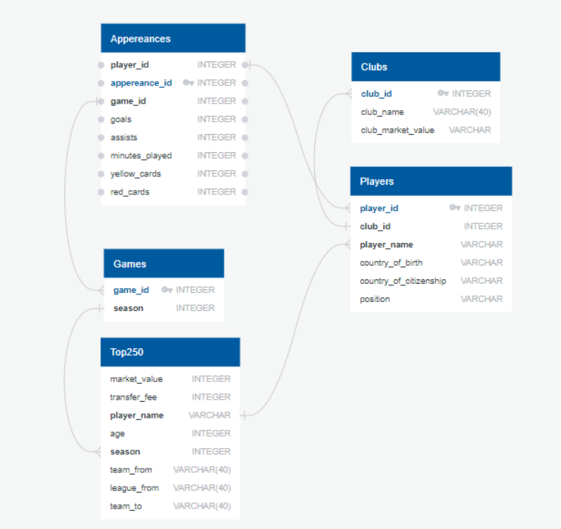
Database
In order to obtain our target values for our model, we needed to join multiple datasets with information from the players club, games, and player market values, we joined our datasets in SQL as shown in our ERD below to:
Notes:
Source:https://www.kaggle.com/davidcariboo/player-scores?select=players.csv
Source:https://www.kaggle.com/vardan95ghazaryan/top-250-football-transfers-from-2000-to-2018

Slide 8
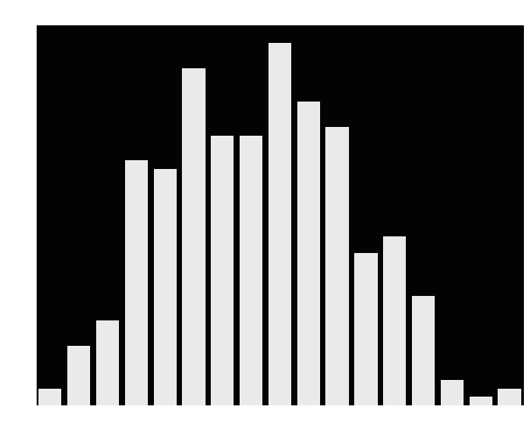
Distribution of age for each Players

Slide 9

Correlation Plot

Slide 10
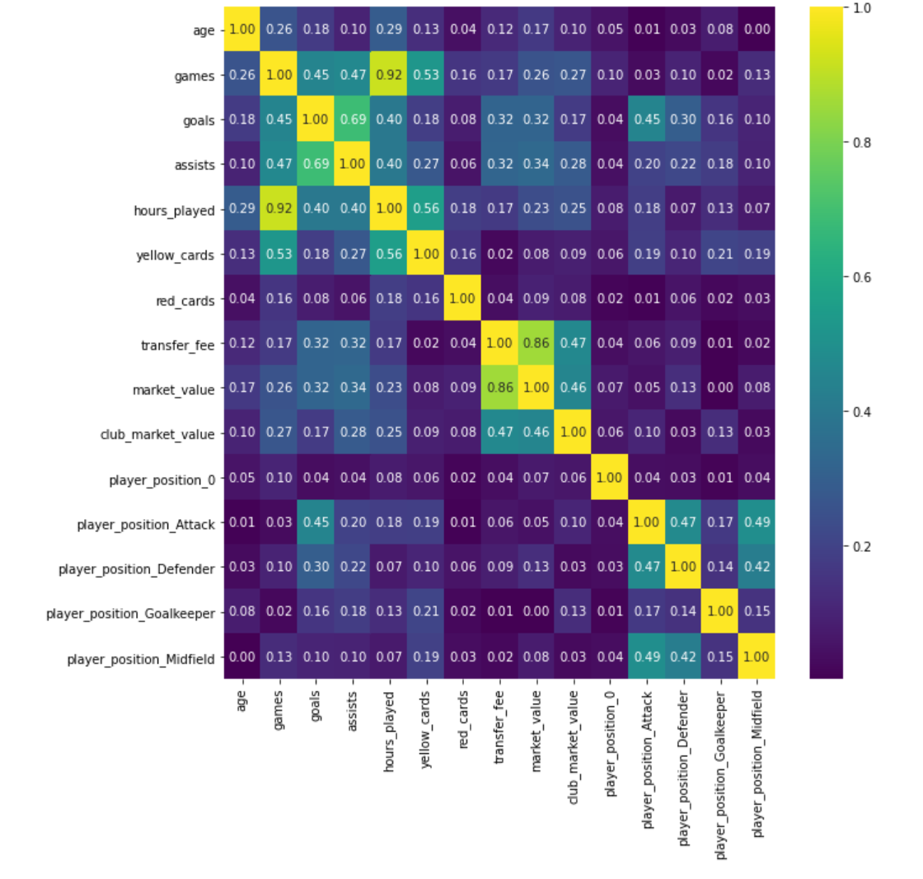
Future Correlation Heatmap

Slide 11
Top 3
Football Players

Slide 12
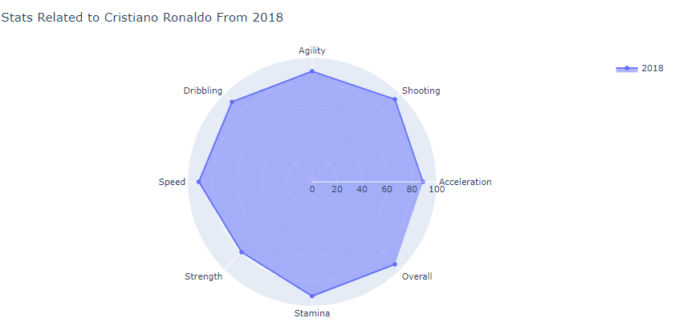
Cristiano Ronaldo Performance

Slide 13
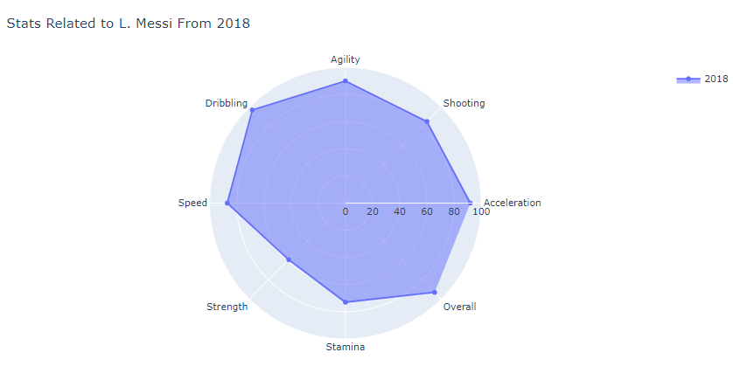
Lionel Messi Performance

Slide 14
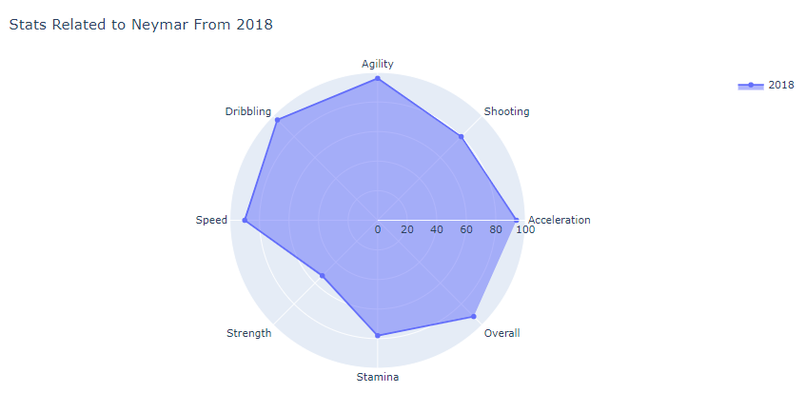
Neymar Jr.
Performance

Slide 15

Potential Features and Target Variable
Club Market Value
Player Position
Red Cards
Yellow Cards
Market value
Assists
Transfer
Fee
Age
Games
Hours Played
Goals

Slide 16
Machine Learning Model
We used a multiple linear regression analysis because the multiple regression model not only helps us to make predictions about the data but also can help us to identify the variables that have a significant effect on the dependent variable (market_value). So it was suitable as well as reasonable for us to use here.

Slide 17
Linear Regression
Notes:
https://github.com/Edgarhv/Predicting-Football-soccer-using-a-Machine-Learning-Model/tree/main

Slide 18
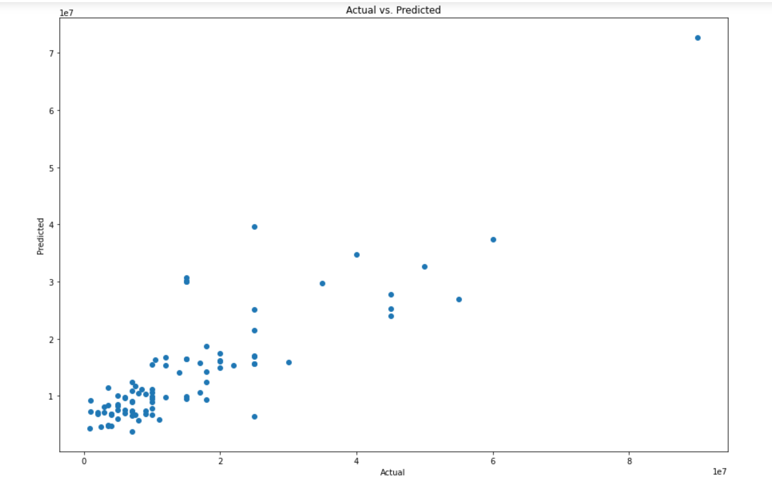

Slide 19
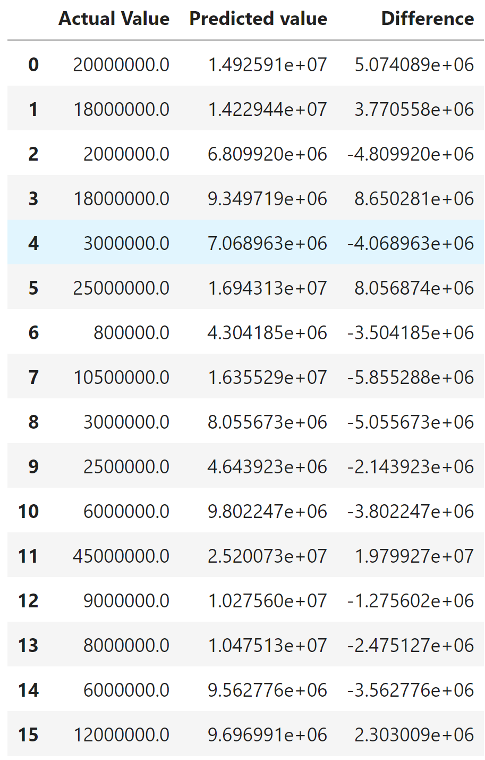
Actual vs Predicted Value
Comparison: Predicted
Value

